Slide 1
Scuba Chat
Project Update 5/3
Akshaya Bhat, Lilian Vu, Sienna Landa, Sophie Harris

Slide 2
Project Overview

Slide 3

Project Objective
Create an underwater transmitter and receiver using a piezoelectric transducer to generate ultrasound waves
Implement the transceiver on our PYNQ FPGAs and ARM cores, with analog elements limited to the transducers, amplifiers, and a bandpass filter on the receiver side.

Slide 4

Minimum Viable Product (MVP)
Basic Goals:
Successfully send information over the underwater acoustic channel
Prototype PYNQ boards with waterproof transducer cabled to it that can be dipped several feet into the water or a swimming pool or lake to send data
Create one Transmitter and one Receiver for one way communication.
Have a high enough data rate to send small snippets of text without noticeable delay
Bit error rate should be around 1% (10⁻²)

Slide 5
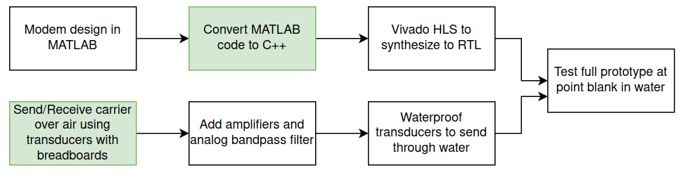
Design Flow
Work In Progress

Slide 6
Last Two Weeks

Slide 7
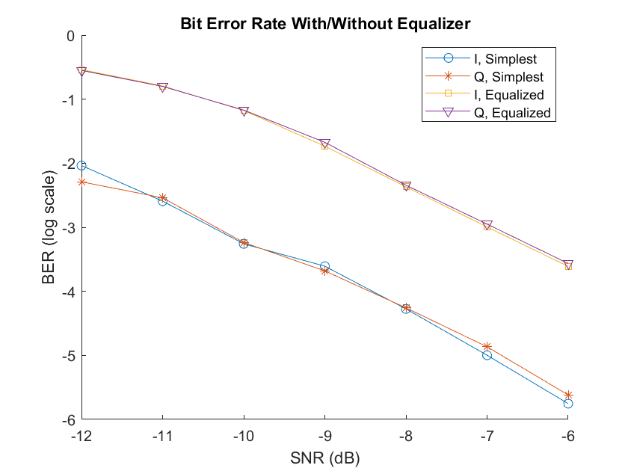
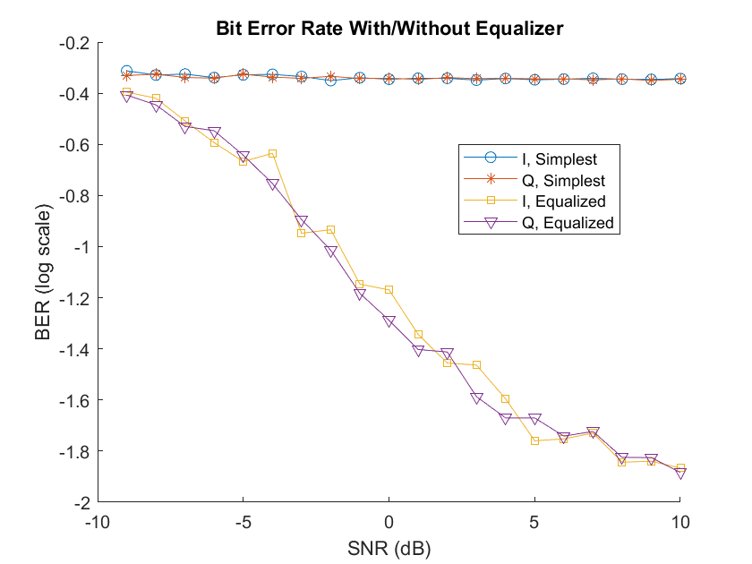
BER Simulation Final Results (Sophie)
Summary: When we apply a severe multipath fading channel to our system, using channel equalization becomes critically important to correctly decoding information

Slide 8
Transmitter Updates (Lilian)
Moved Tx code to ARM core and handed it off to Akshaya to interface with DAC, transducer, and ADC
Made C++ shell on ARM Core to interface
Add in zeros for equalization

Slide 9
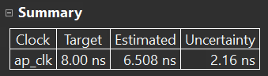
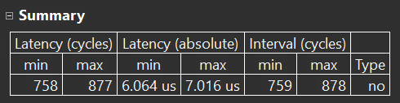
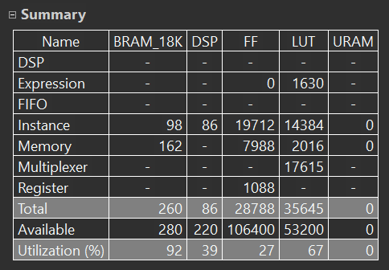
Receiver - Upsampled (Sophie)
Wrote the portion of the receiver which:
Demodulates
Applies matched filter
Identified packet start
Samples at optimal points 1 sample per symbol
Written in C++, optimized for Vitis HLS
Synthesized for PYNQ FPGA
Meets timing requirements to sample at 128kHz from ADC
Is correct within reasonable rounding error

Slide 10
Receiver - Downsampled (Lilian)
Halfway through C++ code after upsample portion of receiver code
Channel equalization ✅
Toeplitz Matrix
PseudoInverse (SVD and Inverse)
Viterbi decoder with soft decision decoding 🔄
Descramble ✅
Intending this portion of code to be on ARM Core

Slide 11
Transmitter Hardware Updates (Akshaya)
Created a user interface application for sending text messages to transmitter library (ARM)
Converts the text messages into binary and stores the modulated and encoded values in a file.
All negative values are transmitted as 0s and all positive values as 1s using GPIO on the jupyter notebook.
Verified DAC to ADC loopback on PYNQ.
Receiver Hardware Updates (Sienna)
Integrated Rx transducer with the PYNQ
Verified that it can detect signals from Tx Transducer circuit.
Implemented analog bandpass filter and integrated it with the Rx circuit.

Slide 12
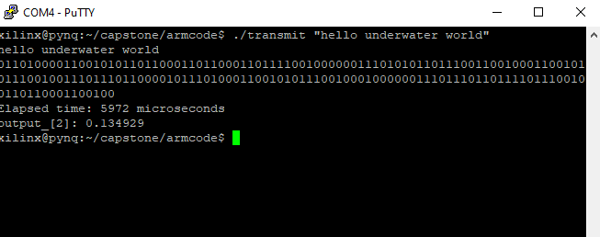
Tx user interface application

Slide 13
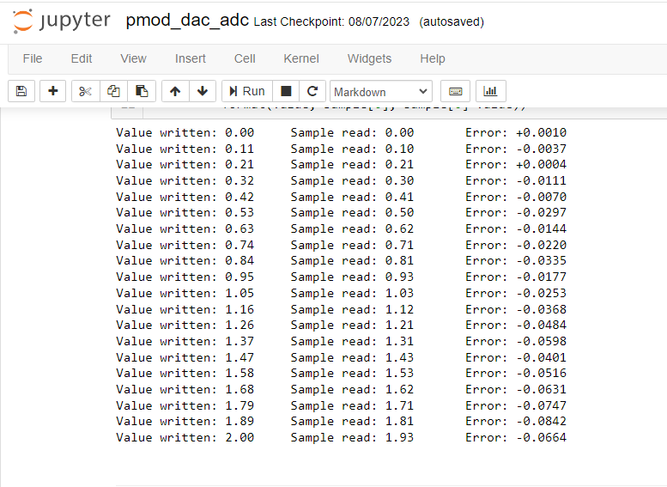
DAC - to -ADC loopback

Slide 14
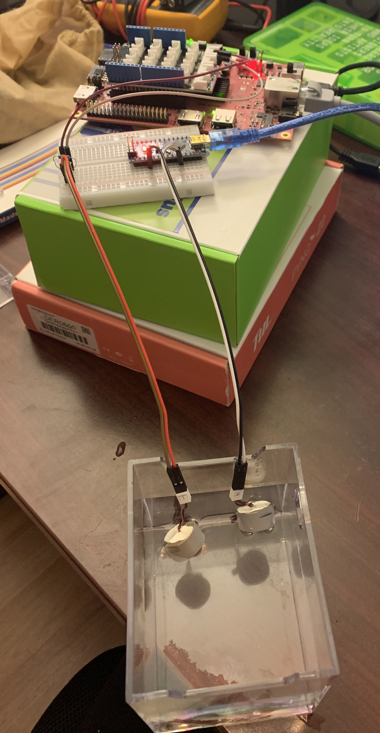
Receiver Hardware Updates (Sienna)
Integrated Rx Transducer with PYNQ
Implemented Analog Bandpass Filter
Verified Rx Transducer on PYNQ is receiving Tx signals

Slide 15
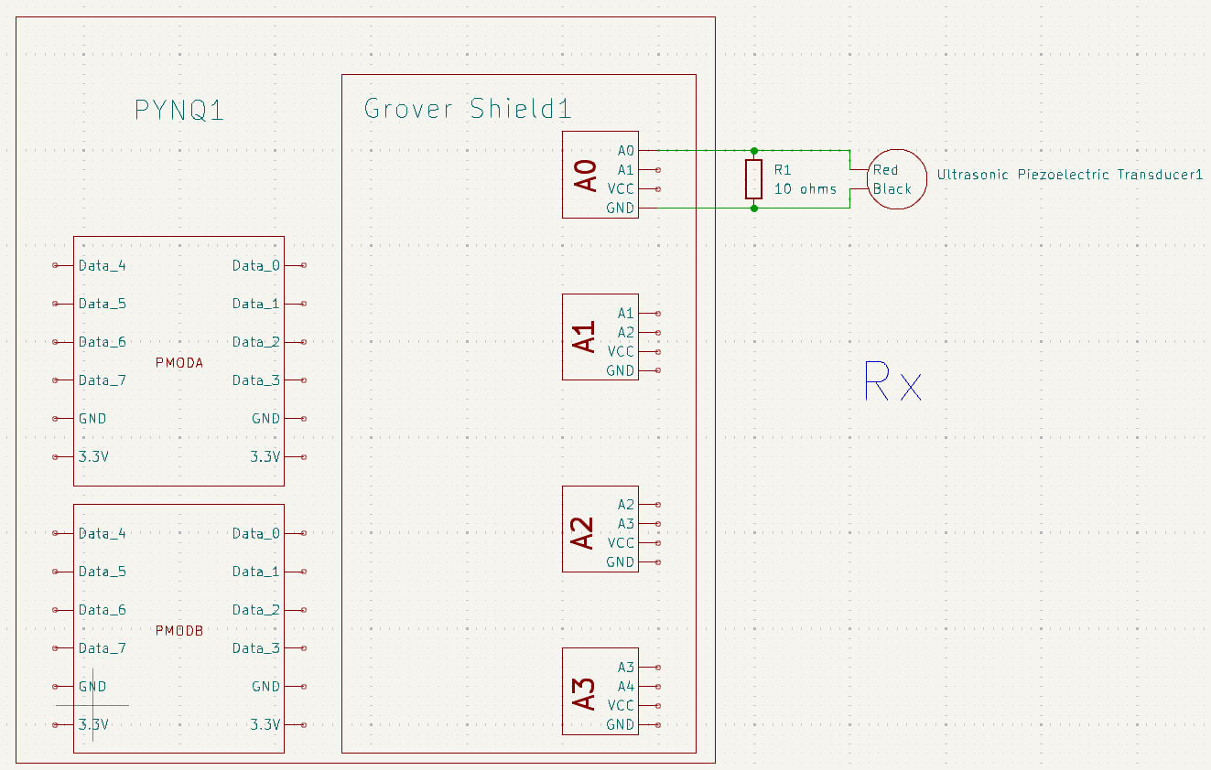
Receiver Hardware Updates (Sienna)
Integrated Rx Transducer with PYNQ
Implemented Analog Bandpass Filter
Verified Rx Transducer on PYNQ is receiving Tx signals

Slide 16
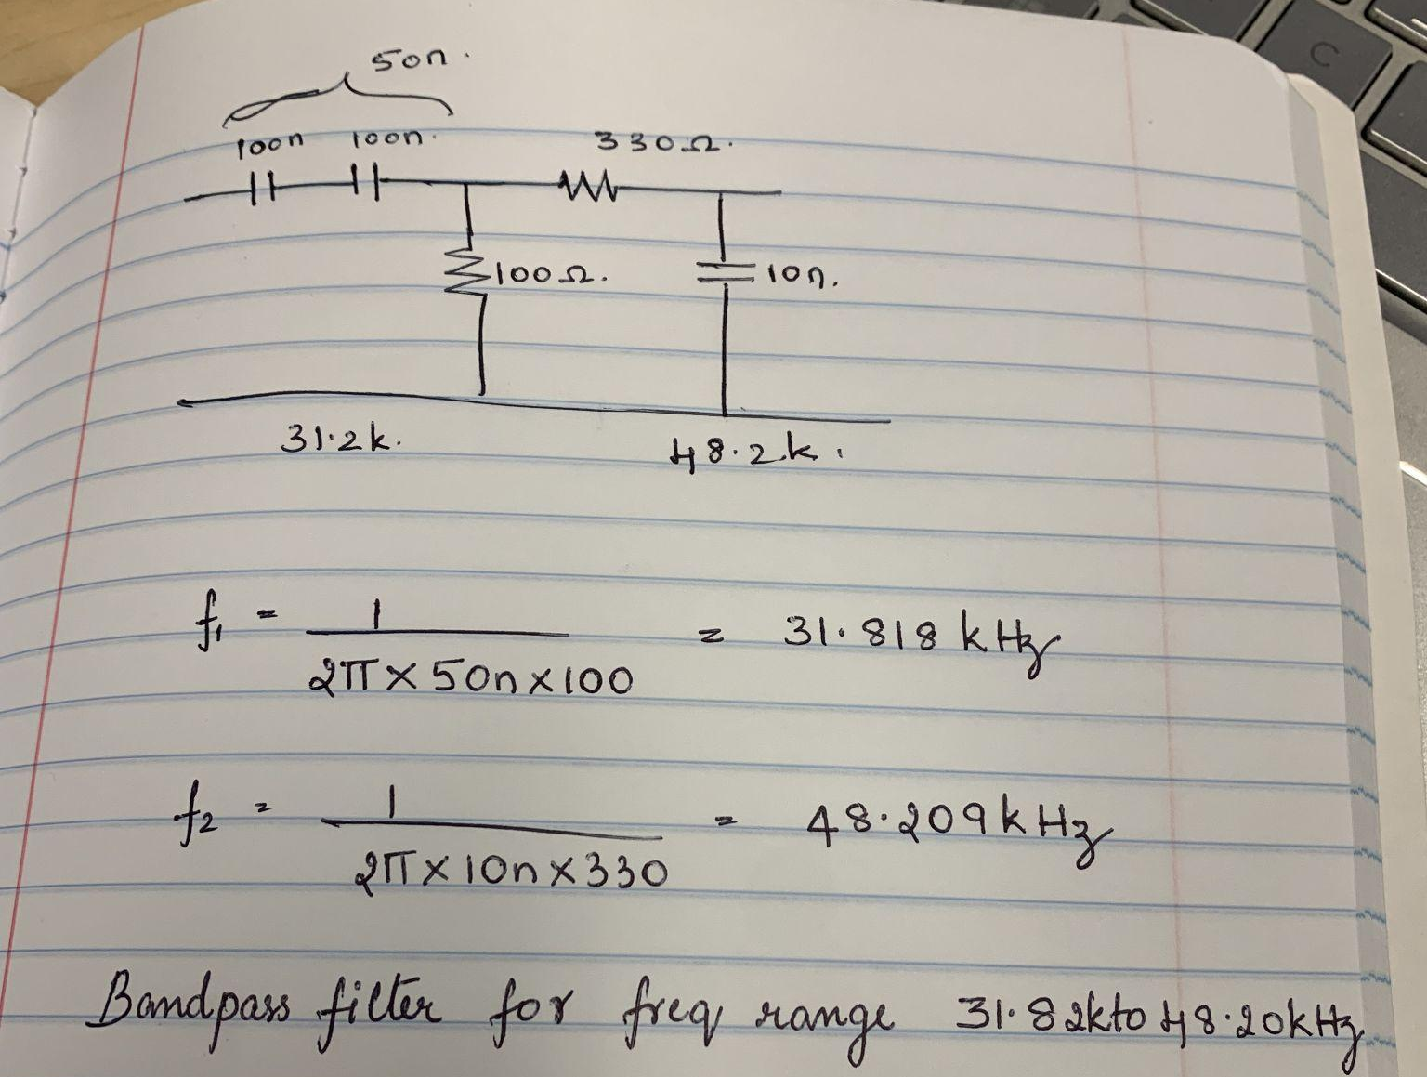
Receiver Hardware Updates (Sienna)
Integrated Rx Transducer with PYNQ
Implemented Analog Bandpass Filter
Verified Rx Transducer on PYNQ is receiving Tx signals

Slide 17
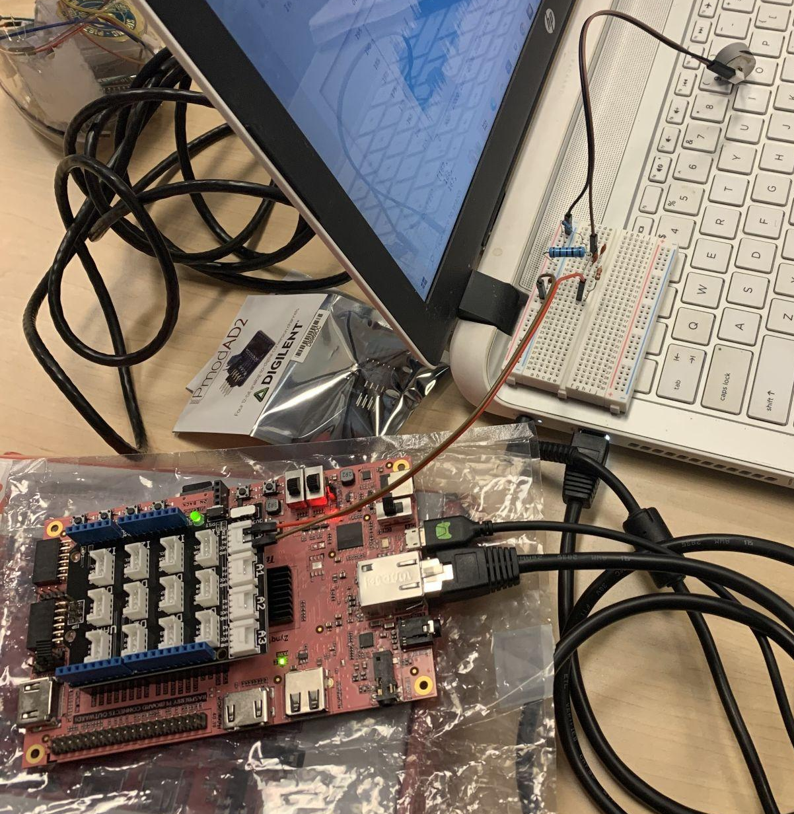
Receiver Hardware Updates (Sienna)
Integrated Rx Transducer with PYNQ
Implemented Analog Bandpass Filter
Verified Rx Transducer on PYNQ is receiving Tx signals

Slide 18
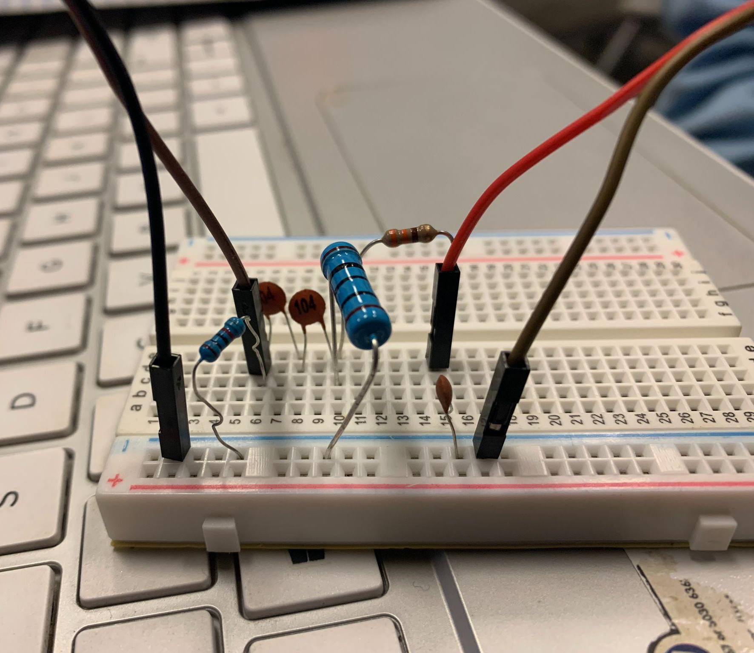
Receiver Hardware Updates (Sienna)
Integrated Rx Transducer with PYNQ
Implemented Analog Bandpass Filter
Verified Rx Transducer on PYNQ is receiving Tx signals

Slide 19
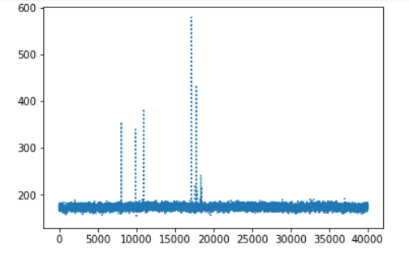
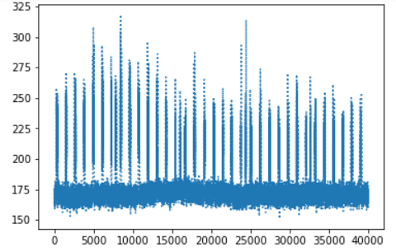
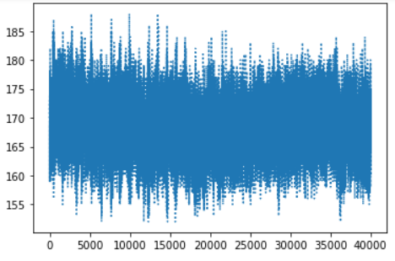
Receiver Hardware Updates (Sienna)
Integrated Rx Transducer with PYNQ
Implemented Analog Bandpass Filter
Verified Rx Transducer on PYNQ is receiving Tx signals
Tapping Rx Transducer (w/ Finger)
Rx Transducer in water w/ Tx Transducer
Rx Transducer sitting in water

Slide 20
Next Two Weeks

Slide 21

Goals for the next 2 weeks
Deadline - Task (Team member)
5/5 - Interface w/ DAC and ADC (Akshaya)
5/5 - Integrate ADC w/ Rx (Akshaya & Sophie)
5/7 - Implement Rx viterbi decoder (Lilian)
5/7 - Verify sine wave is Tx’ed and Rx’ed (Sienna)
5/11 - Test Bandpass Filter (Sienna)
5/11 - Integrate DAC w/ Tx (Akshaya)
5/16 - Implement Tx & Rx User Interface (Sienna)
5/16 - Determine if Automatic Gain Control (AGC) is needed (Akshaya)
5/16 - Integrate upsampled + downsample Rx and optimization (Lilian & Sophie)
5/16 - Test system from Tx to Rx (Everyone)

Slide 22
ADC and Receiver interfacing (Akshaya/Sophie)
Software
Routing for ADC to receiver FPGA block in Vivado
single input value per function call
Find appropriate threshold for identifying packet start (depends on ADC output values)
Interface between FPGA receiver code and ARM core C++ receiver code
Flag to identify when packet values are ready for processing
Buffer containing the symbols themselves
Hardware
Ensure we correctly capture sin waves using the ADC (correct reference voltages)
Keep input voltage to ADC in safe range

Slide 23
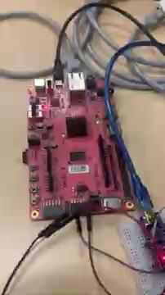
User Interface (Sienna)
1st Goal
Transmit a random signal when a button is pressed
When a signal is received …
Turn on a red LED for S.O.S.
Turn on a green LED for CLEAR
2nd Goal
Display text messages on a LED screen

Slide 24
Receiver code (Lilian)
Implement C++ Viterbi Decoder - 5/7
Merge upsampled receiver code with downsample code - 5/16
Optimize and timing requirements
Integrate on ARM Core with ADC and Sophie’s IP Core

Slide 25
End to End Integration (Everyone)
Start by connecting the transducers with vaseline to transmit with no channel
Fix all of our interface issues between hardware/software and between software blocks
Send a data packet and decode it on the receiver side
We can do this in class because it does not require a large body of water
Once it works, head out to the pool and try through water
If it works with vaseline but not through water, our channel equalization is not good enough or doppler is getting us

